Slide 1
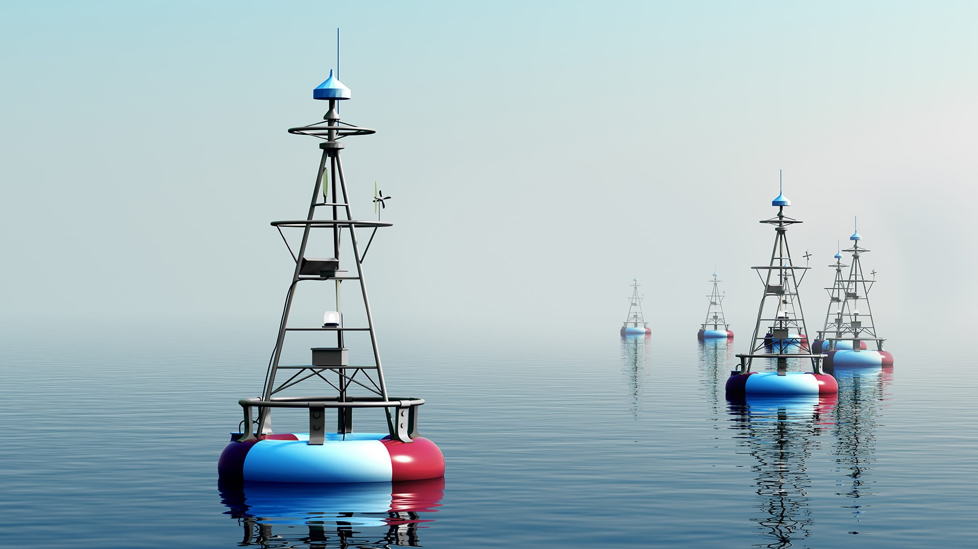
REMOTELY NAVIGATED AUTOMATED WATER QUALITY
SAMPLING SYSTEM
Presented by: PEP_11

Slide 2
AGENDA
01
Introduction
02
Objectives
03
Procedures
04
Personnel & facilities
05
Hardware & Software Requirements
06
Budget
Presenter – IT22310132

Slide 3
AGENDA
01
Introduction
02
Objectives
03
Procedures
04
Personnel & facilities
05
Hardware & Software Requirements
06
Budget
Presenter – IT22310132

Slide 4
AGENDA
01
Introduction
02
Objectives
03
Procedures
04
Personnel & facilities
05
Hardware & Software Requirements
06
Budget
Presenter – IT22310132

Slide 5
AGENDA
01
Introduction
02
Objectives
03
Procedures
04
Personnel & facilities
05
Hardware & Software Requirements
06
Budget
Presenter – IT22310132

Slide 6
AGENDA
01
Introduction
02
Objectives
03
Procedures
04
Personnel & facilities
05
Hardware & Software Requirements
06
Budget
Presenter – IT22310132

Slide 7
AGENDA
01
Introduction
02
Objectives
03
Procedures
04
Personnel & facilities
05
Hardware & Software Requirements
06
Budget
Presenter – IT22310132

Slide 8
AGENDA
01
Introduction
02
Objectives
03
Procedures
04
Personnel & facilities
05
Hardware & Software Requirements
06
Budget
Presenter – IT22310132

Slide 9
AGENDA
01
Introduction
02
Objectives
03
Procedures
04
Personnel & facilities
05
Hardware & Software Requirements
06
Budget
Presenter – IT22310132

Slide 10
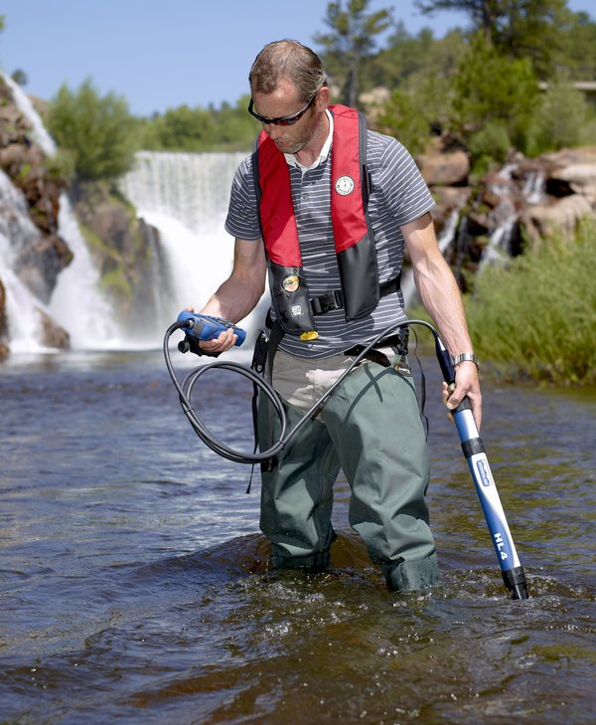
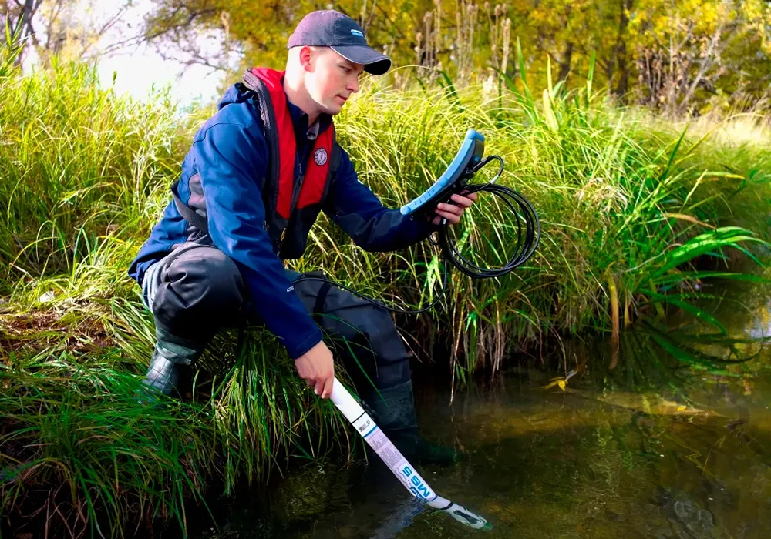
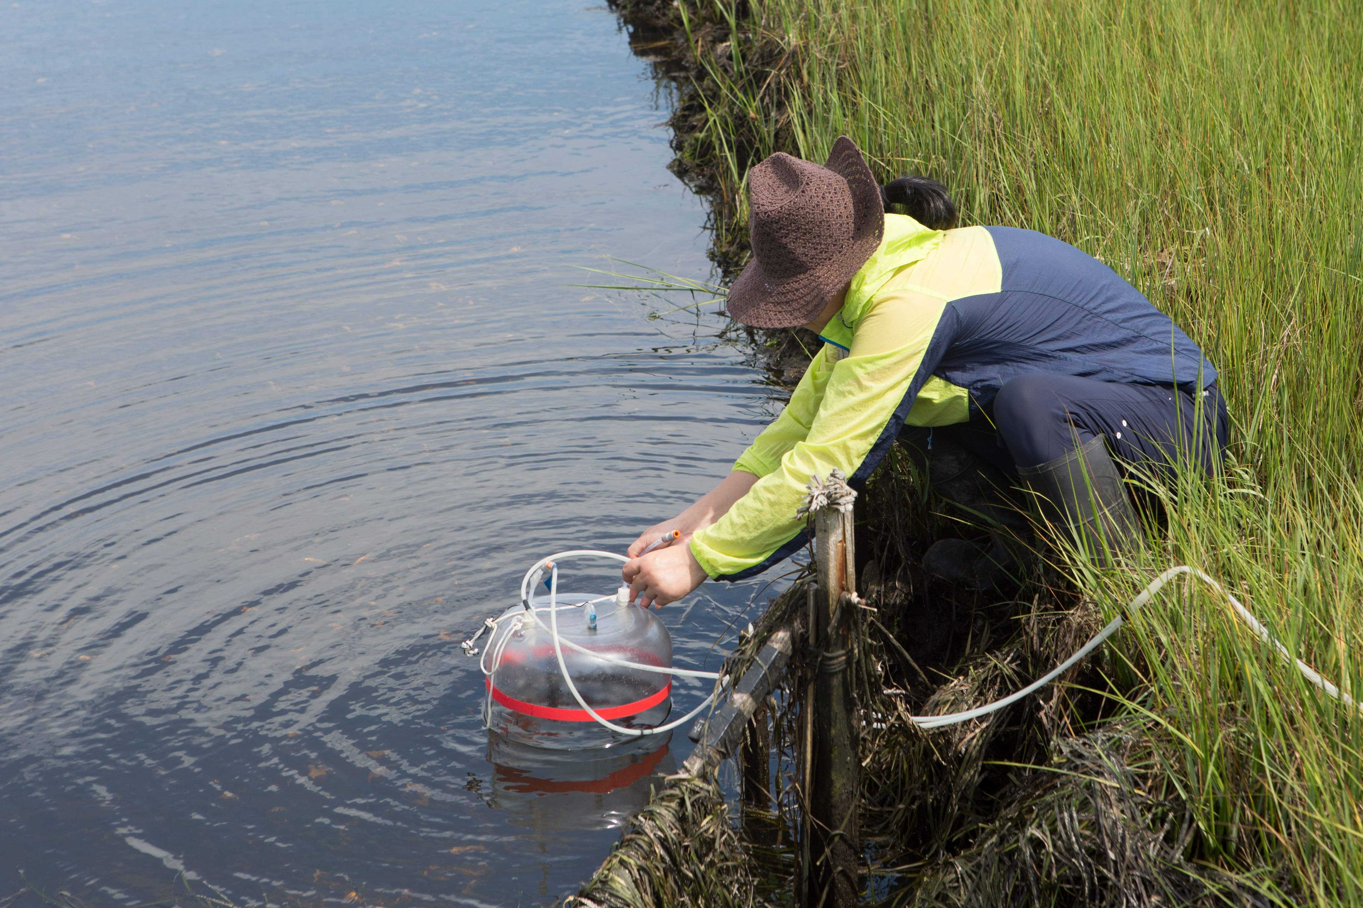
Necessity of human presence at the sampling location.
Major problems,
Limited Data Collection
Safety issues
Inaccessibility of Real-Time Data
Physical inaccessibility to certain areas
Cost & Resource burden
Limited data analysis
Presenter – IT22310132

Slide 11
SOLUTION ARCHITECTURE
Presenter – IT22310132

Slide 12
Benefits
Improved Data Collection
Enhanced safety
Increased Data Accuracy
Real-time data access & analysis
Presenter – IT22032874

Slide 13

Objectives
To develop a water quality measurement system that can be mounted on a remotely navigated boat.
Water pollution monitoring
Reducing associated costs & manpower
User Accessibility
Presenter – IT22320728

Slide 14

Procedures
Flow of the project (Methodology)
Development of robotic arm
Define the requirements.
Identify the range of motion.
Determine the payload capacity.
Choose suitable actuators.
Program the robotic arm.
Verify rotational and vertical movement capabilities of the robotic arm.
Conduct comprehensive testing.
Identify any design flaws or performance issues and fixing them.
Deploy the finalized robotic arm system.
Presenter – IT22310132

Slide 15

Reading pH values using a pH sensor
Identify the hardware requirements.
Draw the circuit diagram.
Wire the setup.
Program the microcontroller.
Calibrate the pH sensor.
Transmit pH data to a web-based dashboard.
Store the received data in a database.
Test the pH sensor device.
Deploy the pH sensor device.
Presenter – IT22320728

Slide 16
Reading turbidity values using a turbidity sensor
Identify the hardware requirements.
Design the circuit diagram.
Wire the setup according to the circuit diagram.
Program the microcontroller to take necessary readings.
Calibrate the turbidity sensor.
Transmit data to a web-based dashboard.
Store the received data in a database.
Test the turbidity sensor device.
Deploy the turbidity sensor device.
Presenter – IT22032874

Slide 17

Location tracking using a GPS tracking system
Determine the specific requirements for the IoT device.
Choose appropriate hardware components.
Configure the GPS module.
Display real-time data and store them in a database.
Test and debug the device.
Deploy the GPS tracking device.
Presenter – IT22083050

Slide 18

Development of a Web-Application and a database
Identify the software requirements of the system.
Find suitable software applications.
Develop the web-based application and the database.
Test and debug.
Deploy the system.
Presenter – IT22032874 & IT22083050

Slide 19
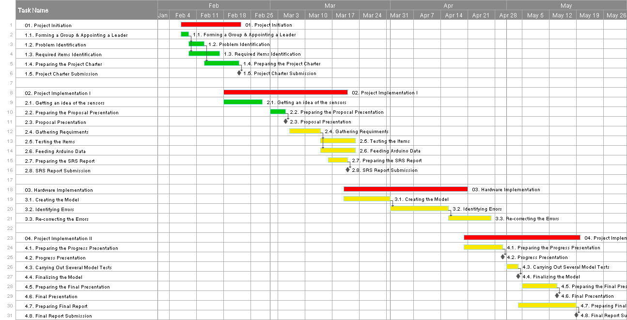
GANTT Chart

Slide 20
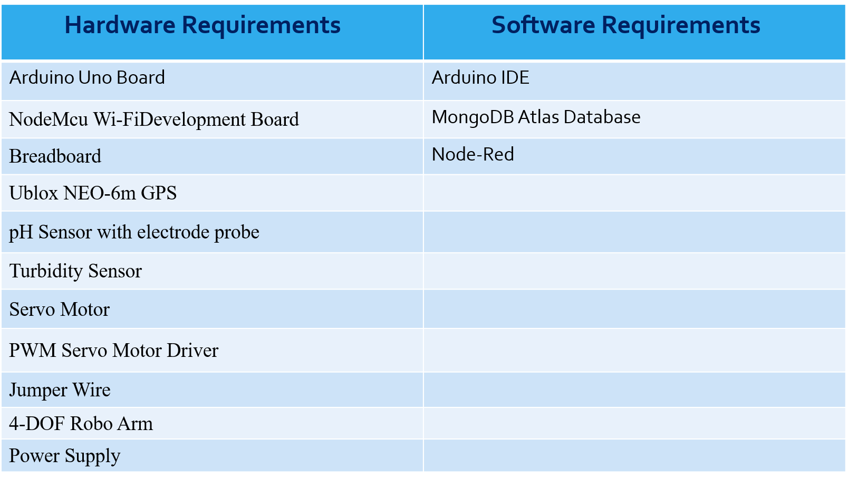
Hardware & Software Requirements

Slide 21
Personnel & Facilities
Student ID / Name | Function Name | Role | Facilities
IT22310132 Muthukumarana T D | Robot Arm Implementation Database Design & Implementation | Project Manager Business Analyst Developer QA | 4-DOF Robot Arm Kit Arduino UNO R3 Servo Motors MongoDB NodeMCU esp8266 Wi-Fi Development Board
IT22032874 Gayanuka Weerasekara | Programming the turbidity sensor. Database Design & Implementation. | Business Analyst Developer QA | Turbidity Sensor Arduino UNO R3 NodeMCU esp8266 Wi-Fi Development Board MongoDB
IT22320728 R A S M Ranawaka | Programming the pH sensor. Robot Arm Implementation. | Business Analyst Developer QA | Liquid PH sensor with electrode probe Arduino UNO R3 Servo Motors 4-DOF Robot Arm Kit
IT22083050 R K Kaween Rashmika | GPS tracking system. Web-based application Implementation | Business Analyst Developer QA | GPS Module NodeMCU esp8266 Wi-Fi Development Board Node-RED

Slide 22
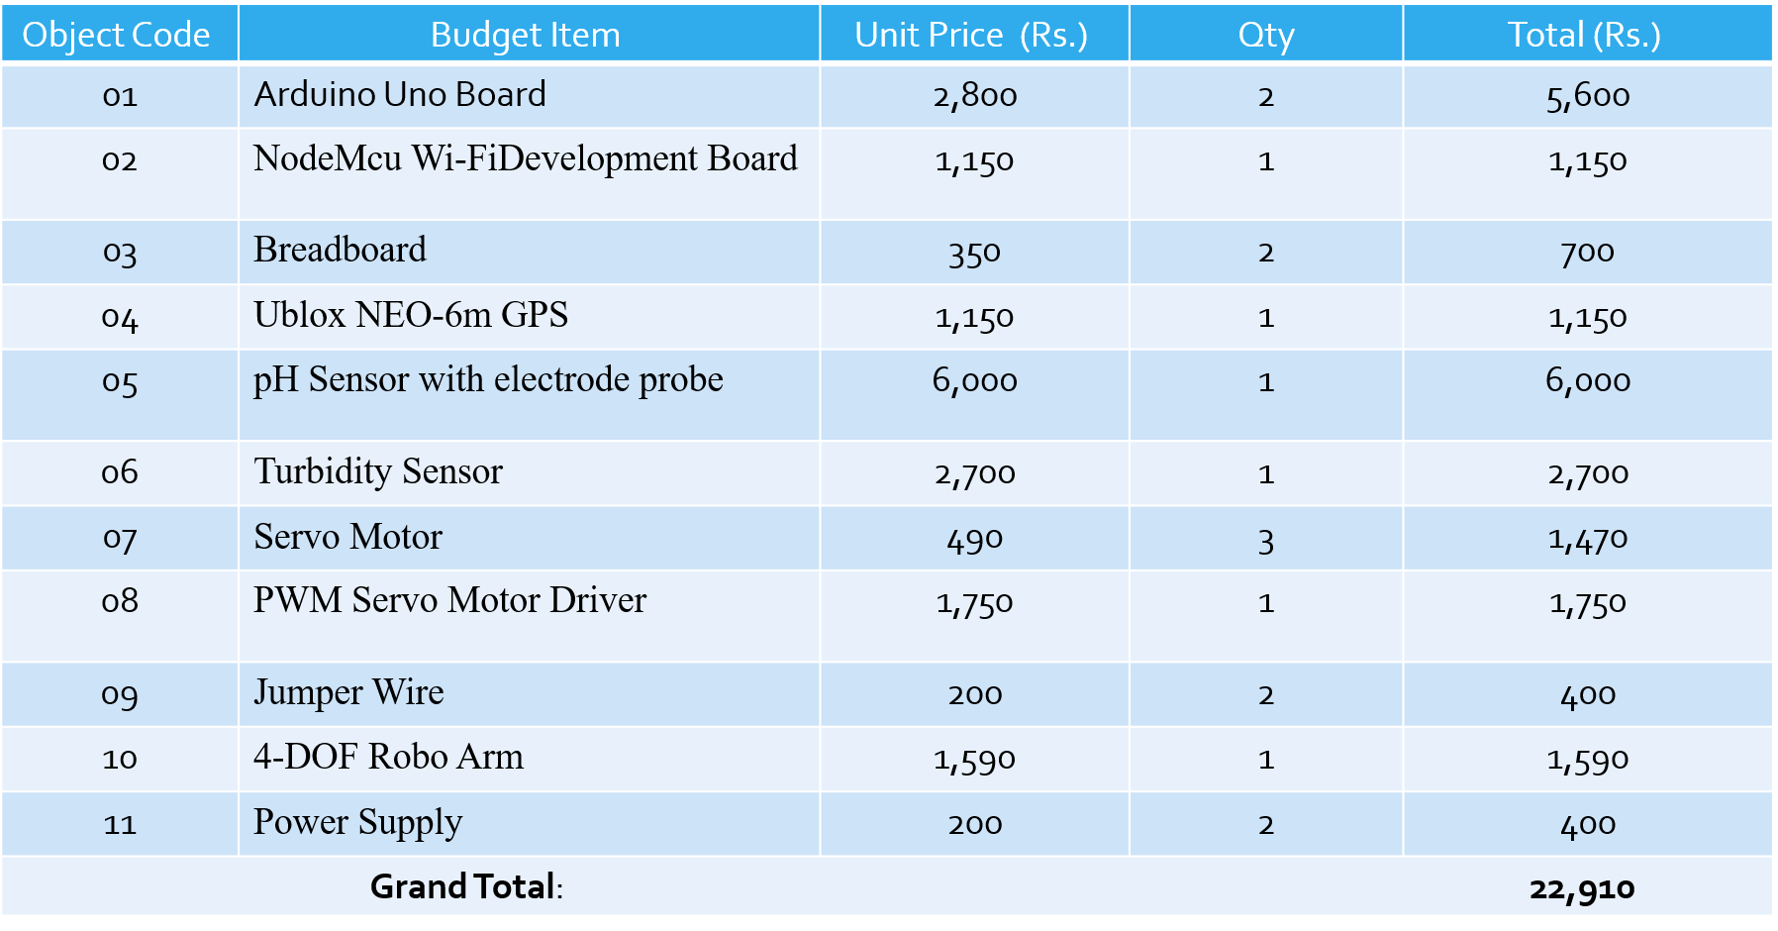
Budget

Slide 23


Slide 24


